Slide 1


No-reference Image Quality Assessment via Non-local Dependency Modeling
Shuyue Jia¹, Baoliang Chen¹, Dingquan Li², Shiqi Wang¹
¹City University of Hong Kong
²Peng Cheng Laboratory
Notes:
Hello, guys. I’m Shuyue Jia. I’m super excited to share our work Non-local Dependency Modeling for no-reference Image Quality Assessment. We call it NLNet.
This is the joint work with Dr. Baoliang Chen, Dr. Dingquan Li, supervised by Prof. Shiqi Wang.

Slide 2
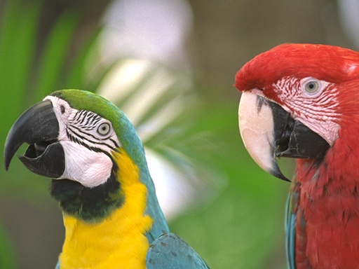
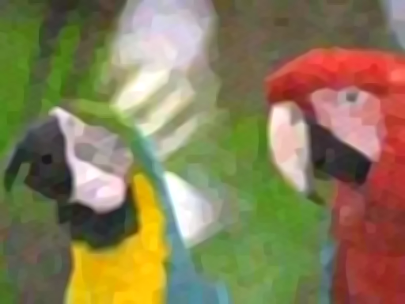
Full / Reduced / No reference
Image Quality Assessment (IQA)
Full Reference IQA
Reference Image
IQA
Model
…
Reduced Reference IQA
Features of
Reference Image
Image Quality
No Reference IQA
Distorted Image
Image Credit: TID2013 Database
Notes:
There are three kinds of objective IQA models classified via the presence of reference images.
With reference images, the full-reference IQA metric optimizes and evaluates current image processing systems.
The reduced-reference IQA algorithms maintain partial information from reference images, for example, a subset of features.
No-reference IQA is highly desirable for most real-world applications where reference images are unavailable. Our work focuses on NR-IQA.

Slide 3
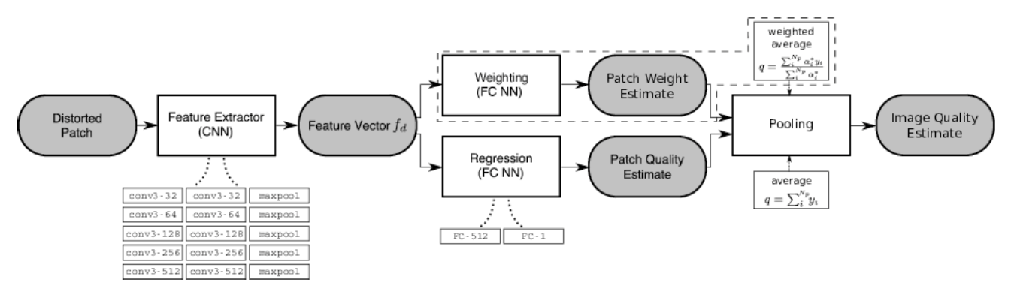
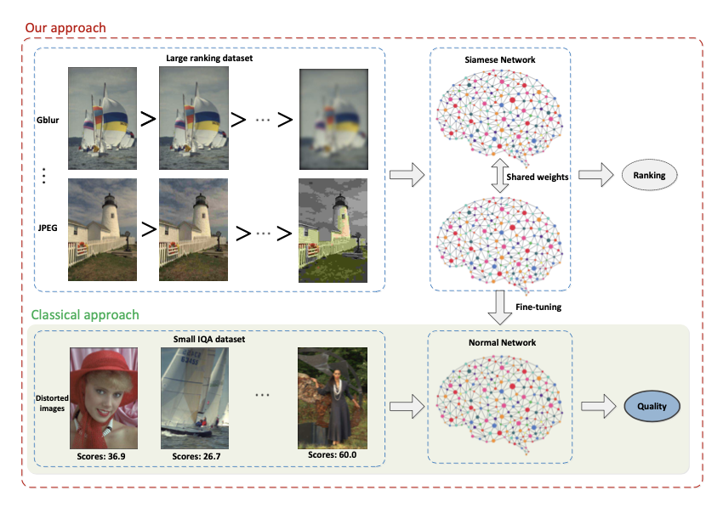
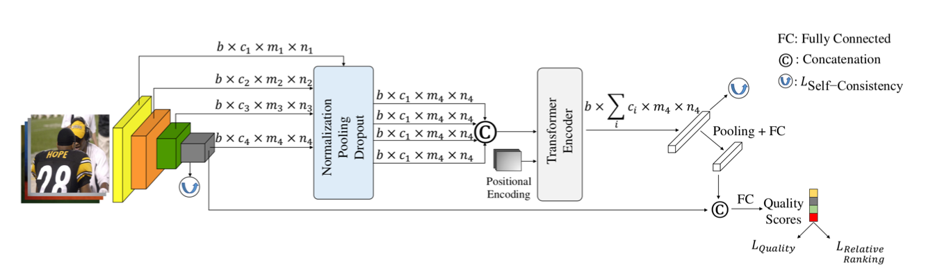
Recent Progress on No-reference IQA
Learning-based Methods [1]
Transformer-based Methods [3]
Rank-based Methods [2]
Credit:
[1] Bosse et al., Deep Neural Networks for No-Reference and Full-Reference Image Quality Assessment, In TIP 2018
[2] Liu et al., RankIQA: Learning from Rankings for No-reference Image Quality Assessment, In ICCV 2017
[3] Golestaneh et al., No-Reference Image Quality Assessment via Transformers, Relative Ranking, and Self-Consistency, In WACV 2022
Notes:
Learning-based methods have achieved superior prediction performance for IQA, especially Convolutional Neural Networks.
Besides, to train a more robust CNN by increasing the amount of data, the rank-based methods attract much attention as the training samples can be enriched in a paired manner.
Most recently, the Transformer-based models were broadly employed indicating that the non-local information plays an important role for IQA.

Slide 4
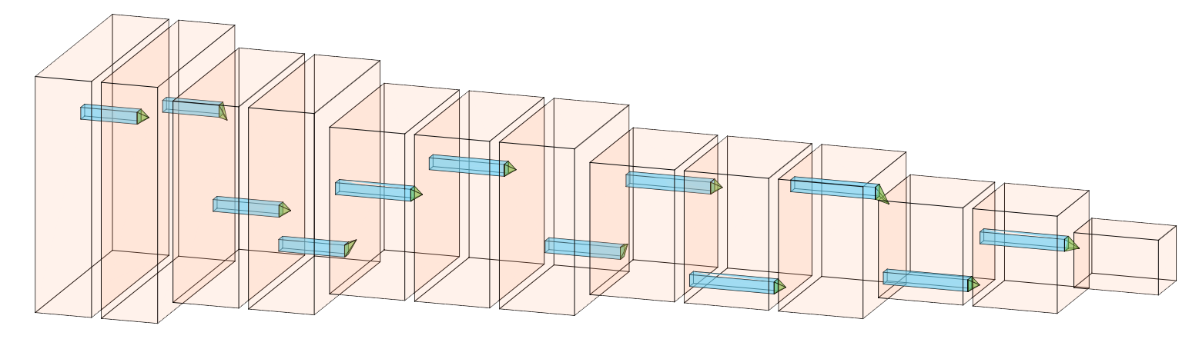
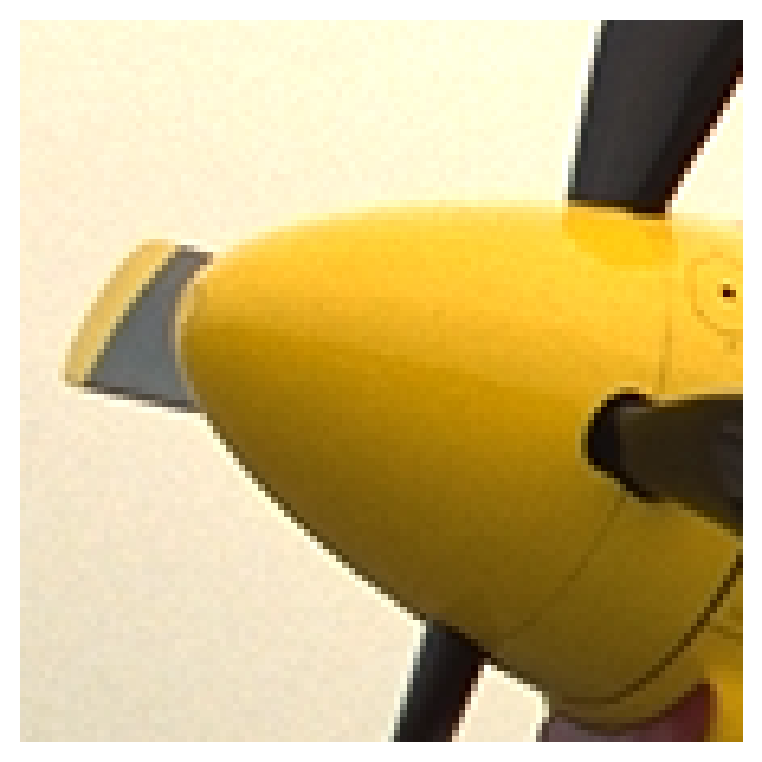
Challenges
Input Patch
Convolutional Neural Networks (CNNs)
Convolutional Neural Networks (Local Modeling):
1. Translation invariance (Pooling)
2. Translation equivalence (Convolution)
3. Fewer trainable parameters (Weights sharing)
Limitations of the local-modeling method:
1. Small-sized receptive field → Extracted features are too local
2. Parameters fixed across the whole image → Contents are equally treated
3. Lack of geometric and relational modeling → Complex relations and layouts
Notes:
There are many advantages of the local modeling, such as Translation invariance and Translation equivalence.
However, the CNN filters extract features mainly from the local neighborhoods. Thus, it is hard to catch the non-local features and long-range dependencies among pixels and regions from the image.
Moreover, since the content in an image is multi-scale and space-variant, the CNN filters equally process it which should be treated distinguishingly.
Further, CNN fails to model the geometric and relational causal dependencies.
As such, suffered by the local priors to CNN, the non-local information is usually absent.

Slide 5

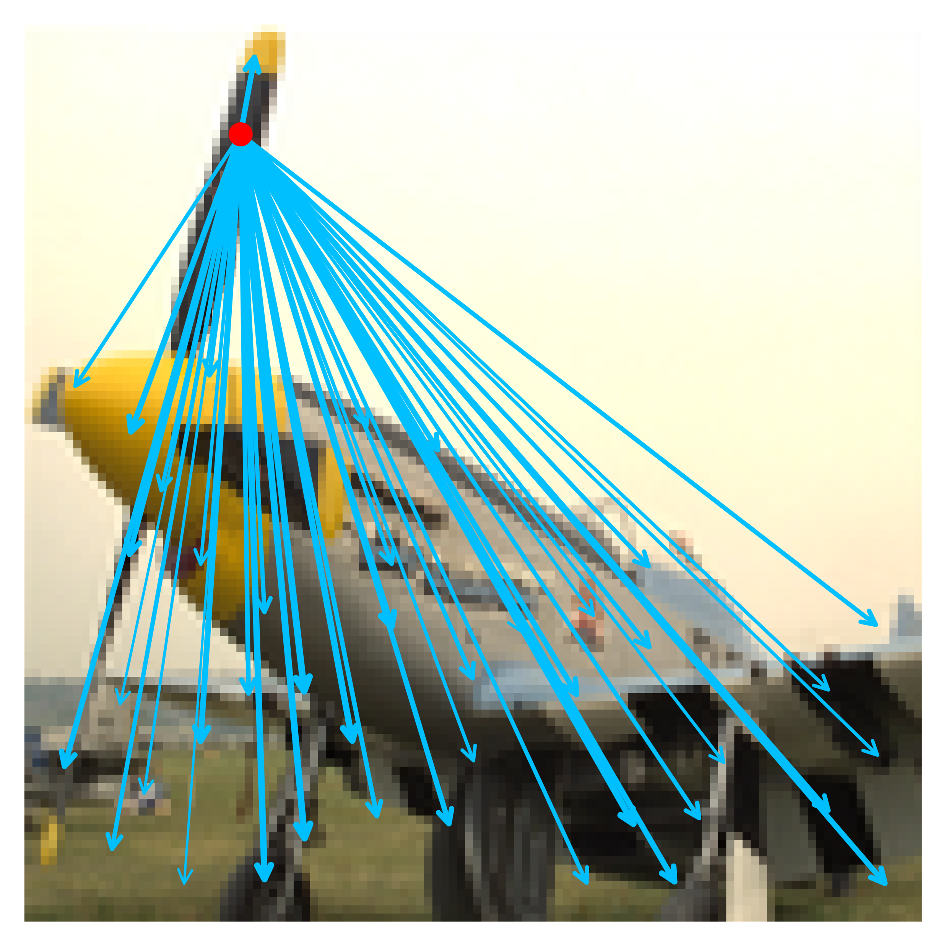
Motivation of NLNet
1. HVS is adaptive to local contents:
→ Local appearance artifacts affect the overall quality
2. HVS perceives image quality with long-dependency constructed among different regions
→ Non-local feature extraction for long-range dependency modeling
Local Feature Extraction is critical
Non-local Dependency
Learned by the NLNet
Image Credit: TID2013 and LIVEC Databases
Notes:
The motivation of our work is that the human visual system is adaptive to local contents and perceives image quality with long-dependency constructed among different regions.

Slide 6
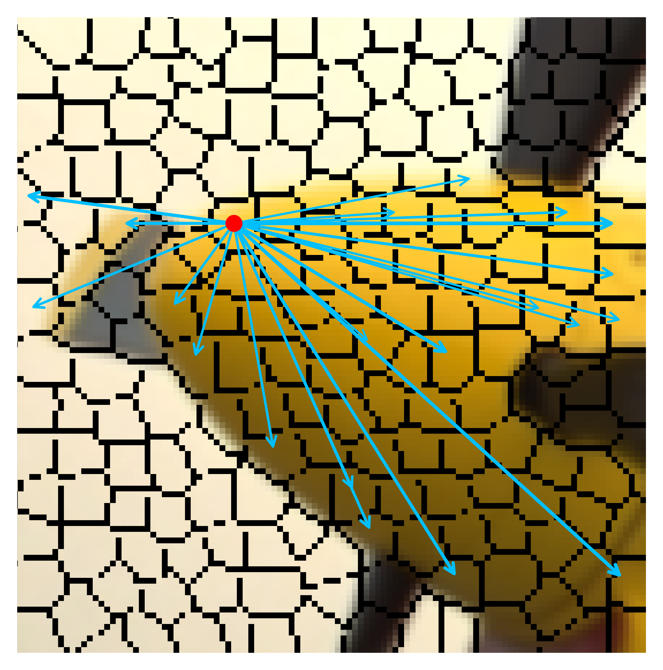
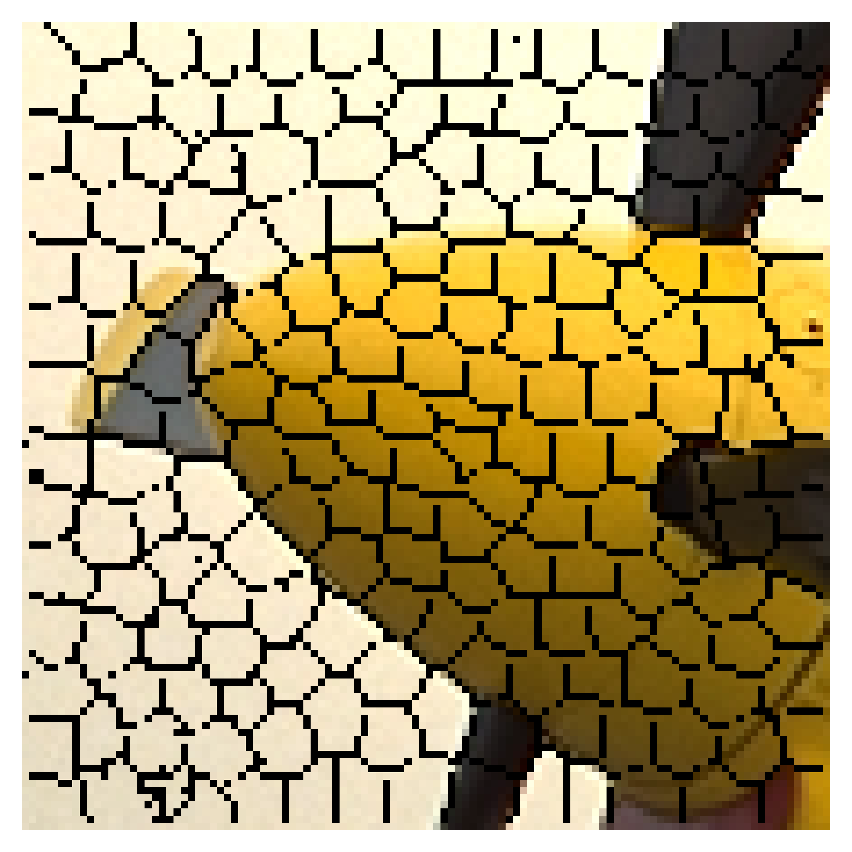
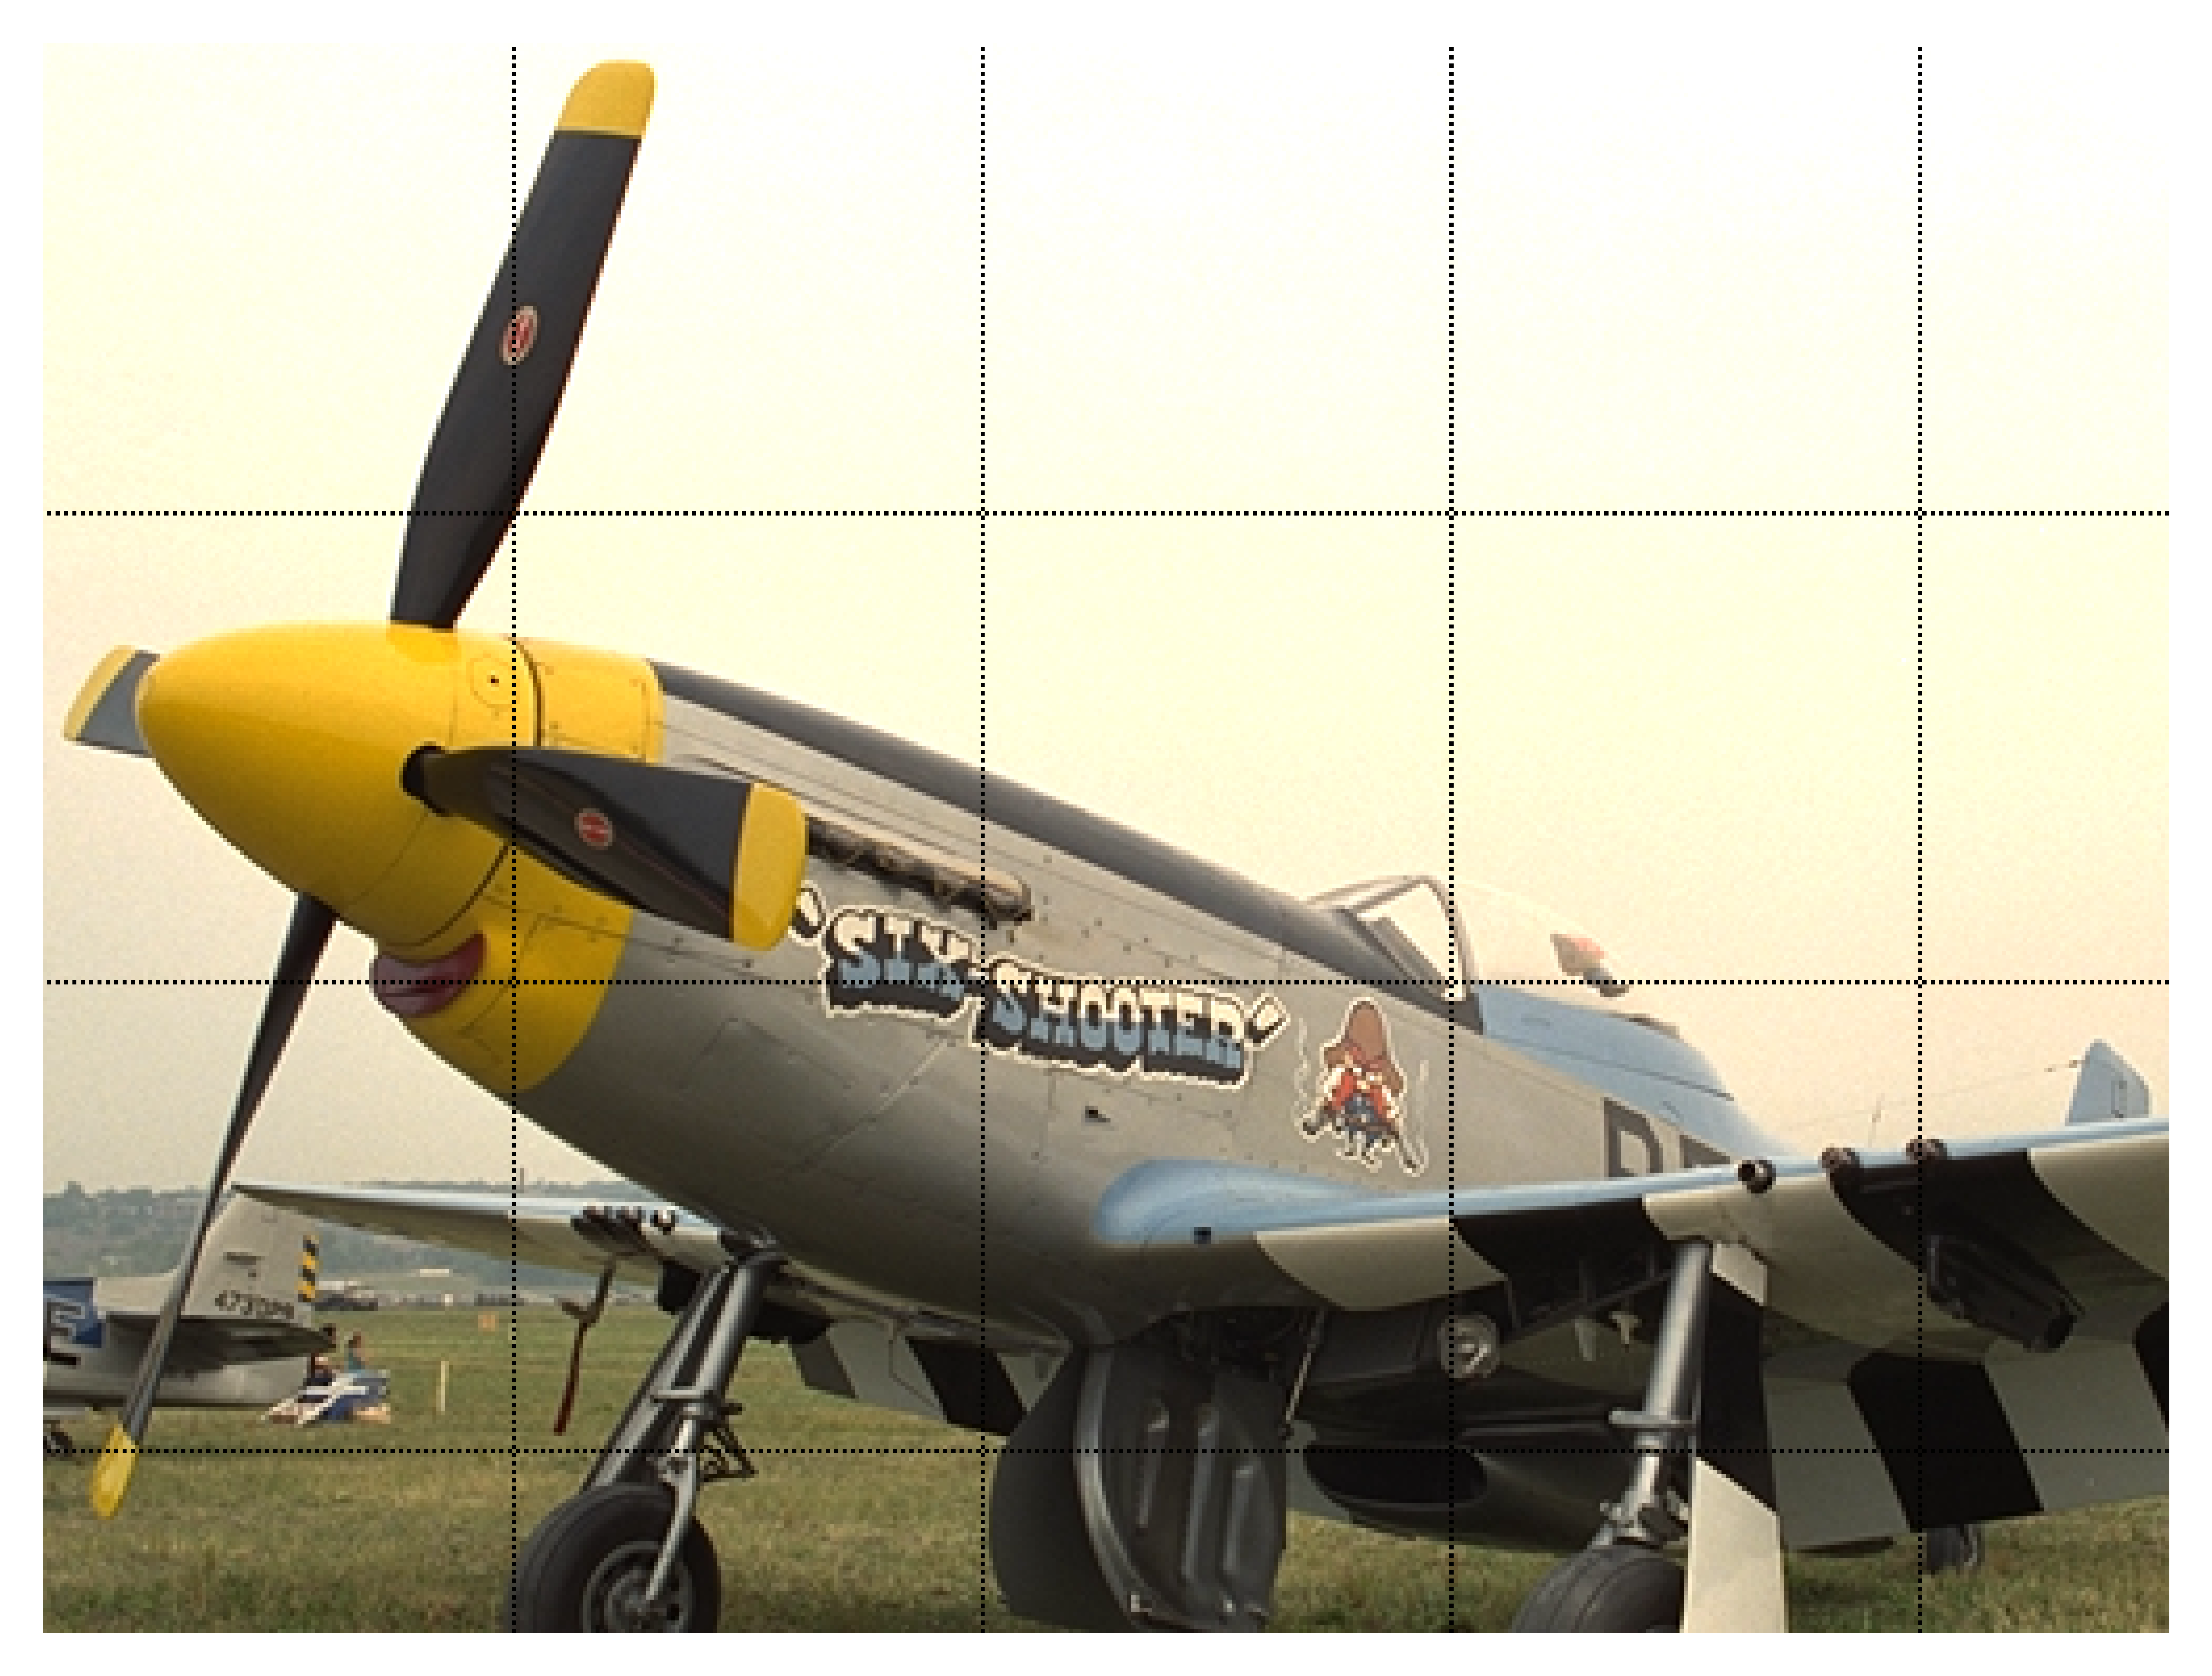
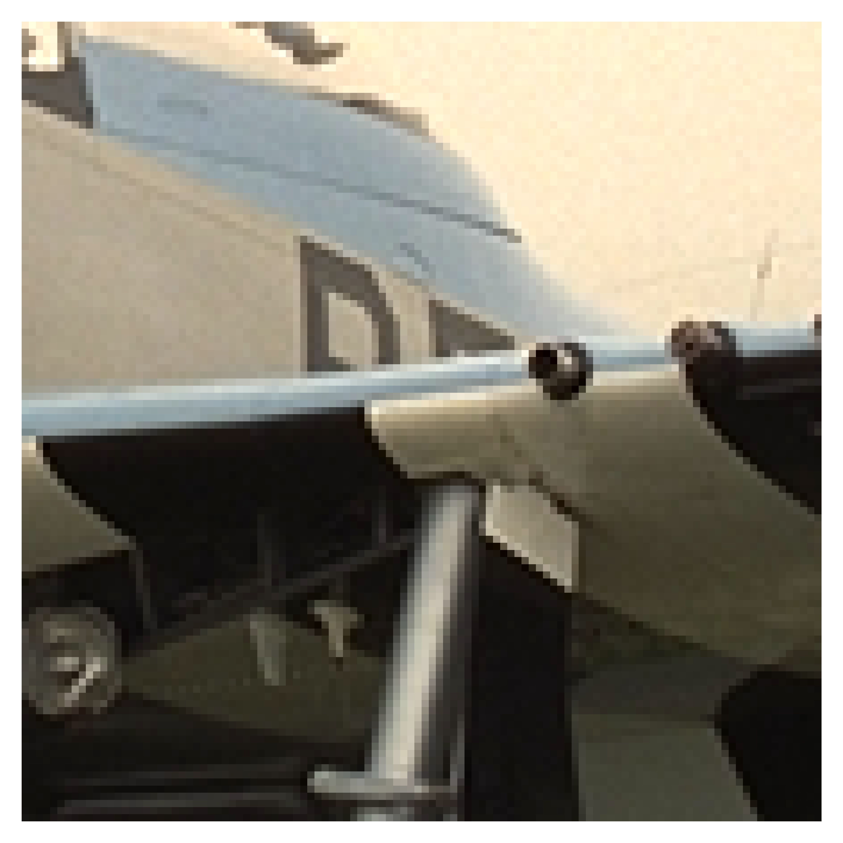
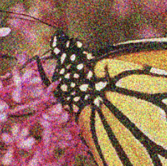
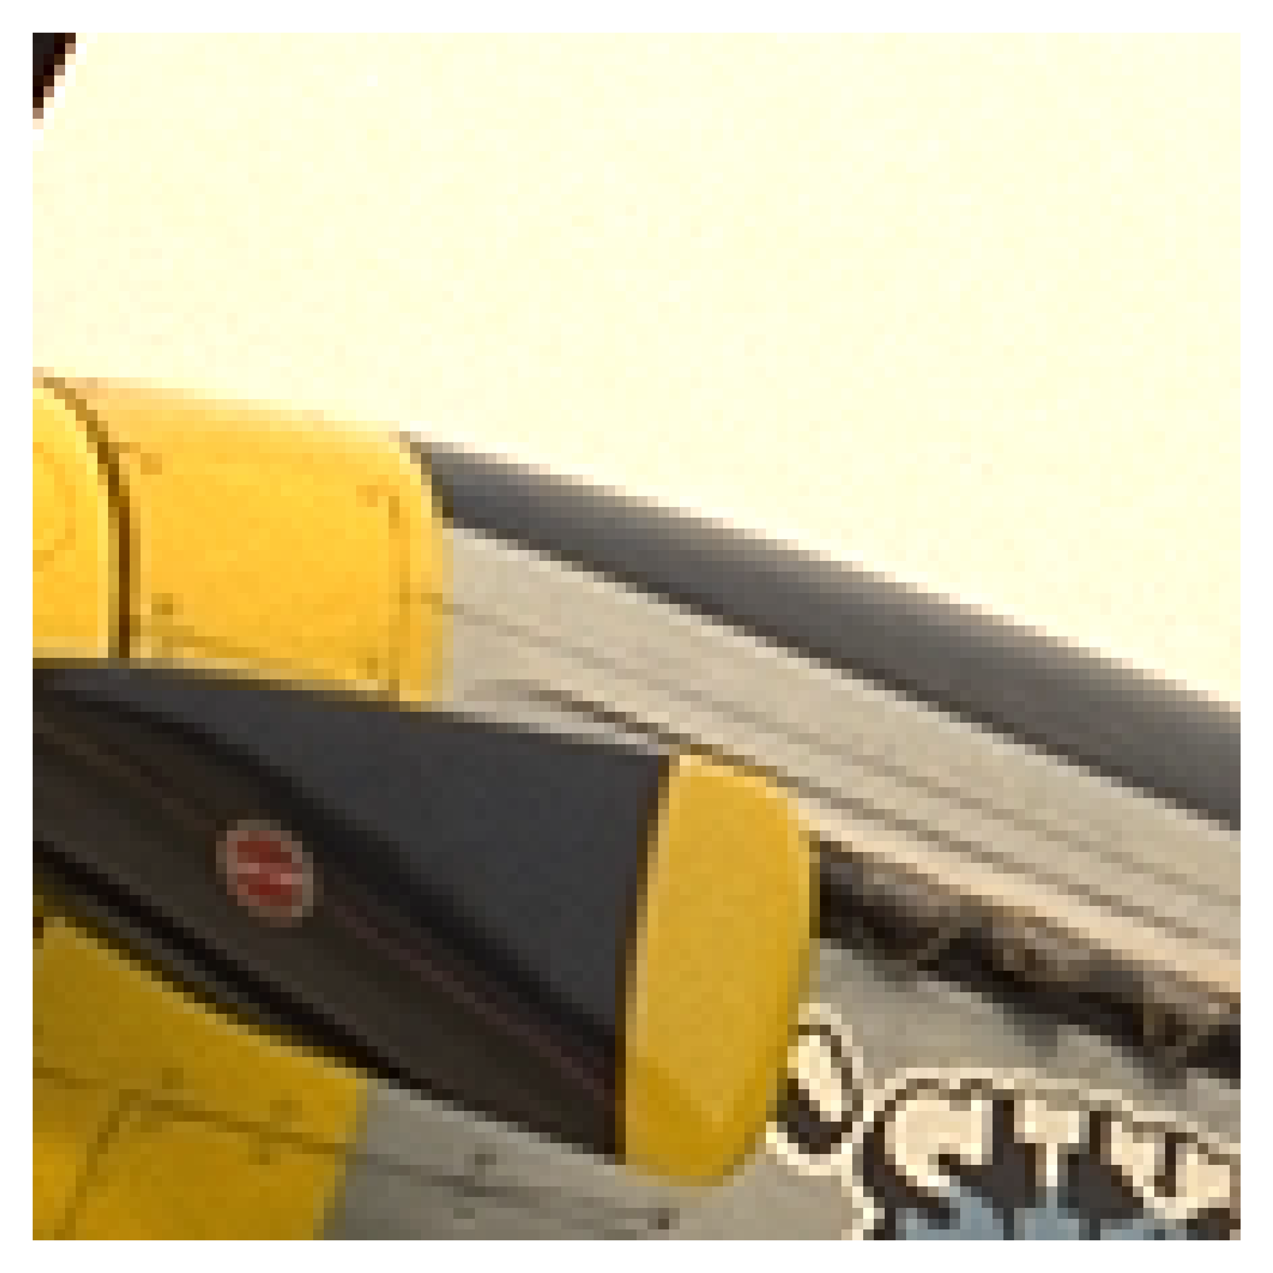
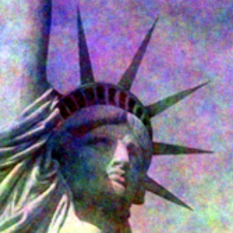

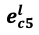
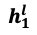
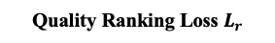
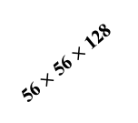
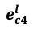
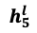
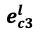
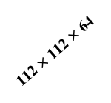
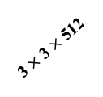
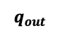
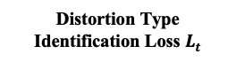
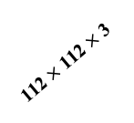
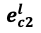
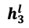
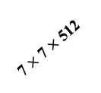
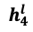
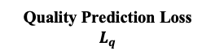
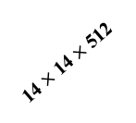
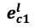
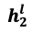
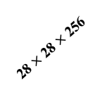
NLNet
Architecture
Superpixel
Cosine
$$h_{5}^{l}$$
$$e_{cc}^{l}$$
Stage One:
Local Feature
Aggregation
$$e_{c5}^{l}$$
$$e_{c1}^{l}$$
$$h_{1}^{l}$$
Similarity
$$h_{4}^{l}$$
$$e_{c4}^{l}$$
$$h_{c}^{l}$$
$$e_{c3}^{l}$$
$$e_{c2}^{l}$$
Stage Two:
Non-Local Feature
Aggregation
$$h_{3}^{l}$$
$$h_{2}^{l}$$
Input Patch with
Superpixel Segmentation
(ii) Graph Neural Network – Non-Local Modeling Method
One GNN Layer and the GNN module
(iv) Feature Mean & Std Fusion and Quality Prediction
Input
Distortion Type Identification Loss $L_{t}$
Quality Prediction Loss $L_{q}$
Quality Ranking Loss $L_{r}$
Inference – Final Quality Prediction
..
D
$$1$$
Image Pair
Rank
$$q_{out}$$
FC
FC
…
…
Average
512
512
112 $×$ 112 $×$ 3
112 $×$ 112 $×$ 64
56 $×$ 56 $×$ 128
The Evaluated Image
28 $×$ 28 $×$ 256
14 $×$ 14 $×$ 512
(i) Image Preprocessing
7 $×$ 7 $×$ 512
3 $×$ 3 $×$ 512
Image Credit: TID2013 Database
Input Patch
(iii) Pre-trained VGGNet-16 – Local Modeling Method
Notes:
We design a superpixel-based graph neural network approach to capture the non-local features.
Finally, the local and non-local features are fused for image quality regression.
We also employed distortion type classification and quality ranking to extract more quality discriminative features.

Slide 7
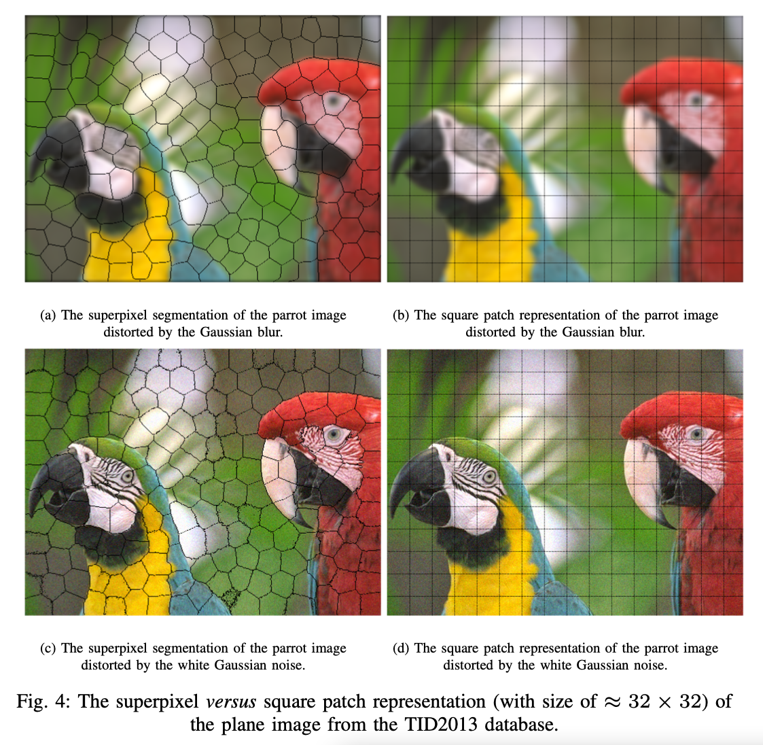
SLIC Superpixel Segmentation
Superpixel versus Square Patch
Adherence to boundaries and visually meaningful
Accurate feature extraction
Image Credit: TID2013 Database
Notes:
Compared with features derived from the standard pixel grids, superpixels can be adaptive to regional content and generate more meaningful representations.
Thus, the natural scene statistics can be well-exploited.

Slide 8
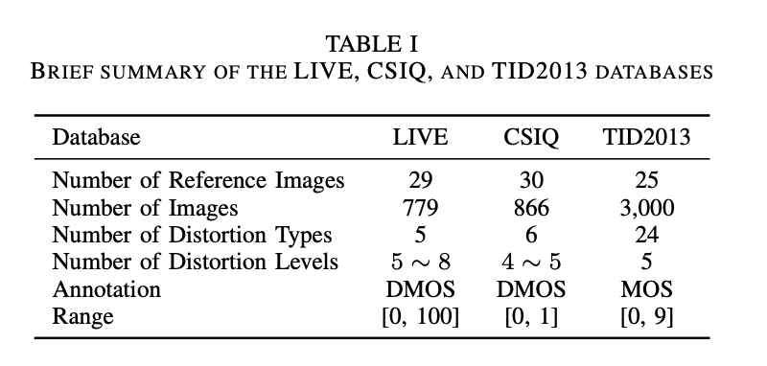
Experimental Setup
Dataset:
LIVE, CSIQ, TID2013
Evaluation metrics:
SRCC (Spearman Rank-order Correlation Coefficient)
PLCC (Pearson Linear Correlation Coefficient)
Experimental setting:
Intra-database Experiments:
→ 60% training, 20% validation, and 20% testing, with random seeds from 1 to 10
Cross-database Experiments:
→ One database as the training set, and the other databases as testing set
→ Report the last epoch’s performance
Notes:
The proposed NLNet is evaluated on three natural image IQA benchmarks, including the LIVE, CSIQ, and TID2013 databases.
Details of these databases are in Table I.
used PLCC and SRCC to evaluate model performance.
And the following is the experimental setting of our work.

Slide 9
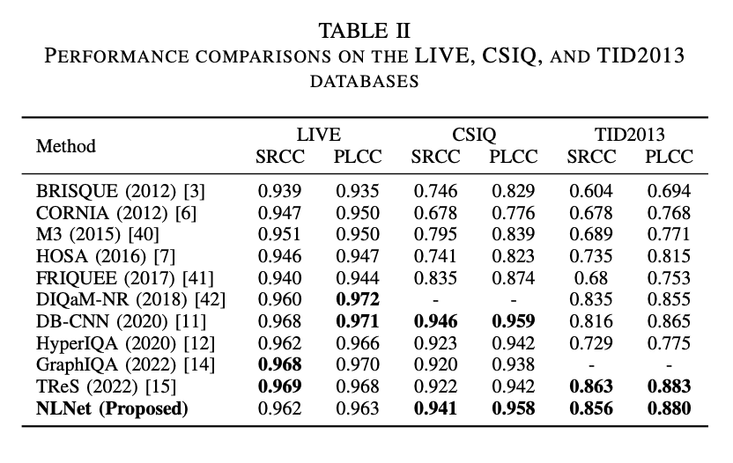
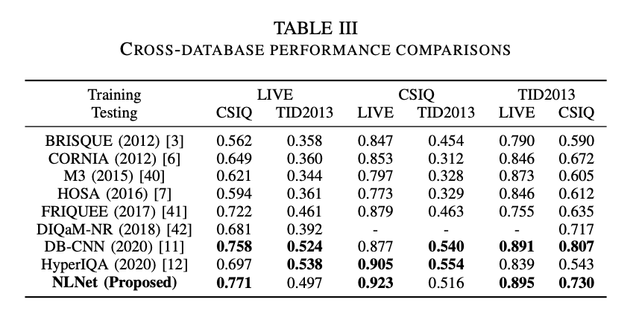
Experimental Results
Competitive performances compared with those 80% train and 20% test methods.
Superior cross-database performances.
Notes:
The results indicate the usefulness of non-local feature extraction, and the superior performance in cross-dataset settings verifies the high generalization capability of our proposed method

Slide 10
THANK YOU!
Code: https://github.com/SuperBruceJia/NLNet-IQA
Acknowledgement:
Helpful discussions with Dr. Xuhao Jiang, Dr. Diqi Chen, and Dr. Zhijian Hou.
Notes:
Thanks for your listening. Code is publicly available.

